Slide 1
freeRTOS Setup on the Tiva C Launchpad
Target: TM4C123GHPM on the Tiva C Launchpad
IDE: Kiel uVision5 V:5.38.0.0
Kevin Ehrichs – CS467 – Team Unicorn

Slide 2
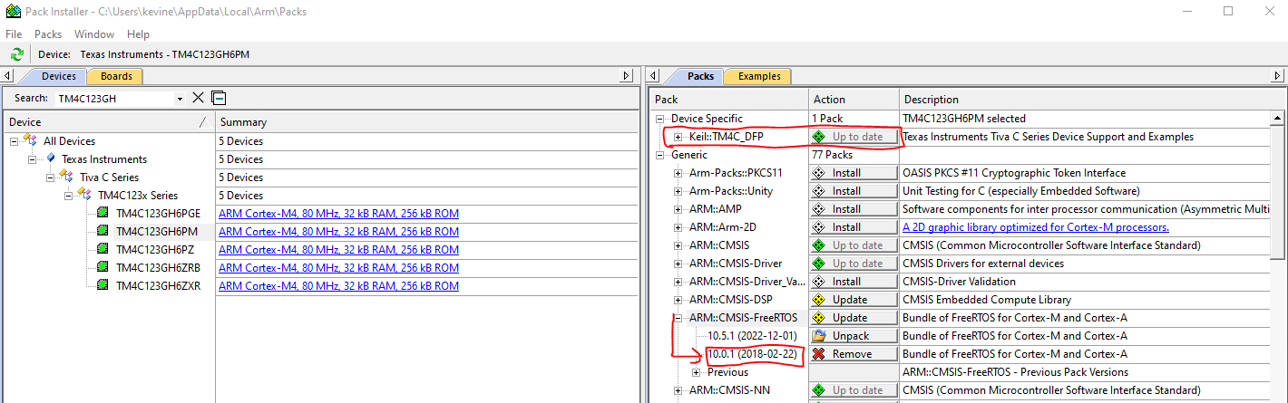
Install Packs
Open Kiel uVision5 and click on the pack installer Icon
Install the TM4C_DFP Package
Install the CMSIS-FreeRTOS Package (V10.0.1 was used in this setup)

Slide 3
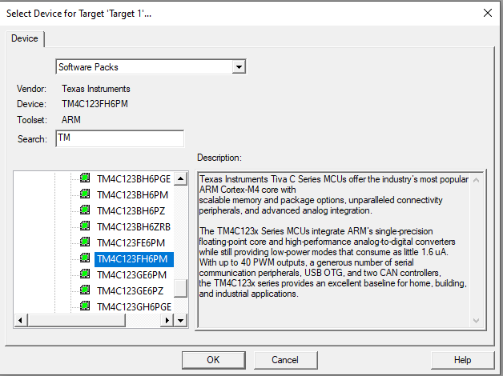
Create a new project
Select Project-> New uVision Project
Create a name for the project – save to a new folder
Then select the correct target and click OK

Slide 4
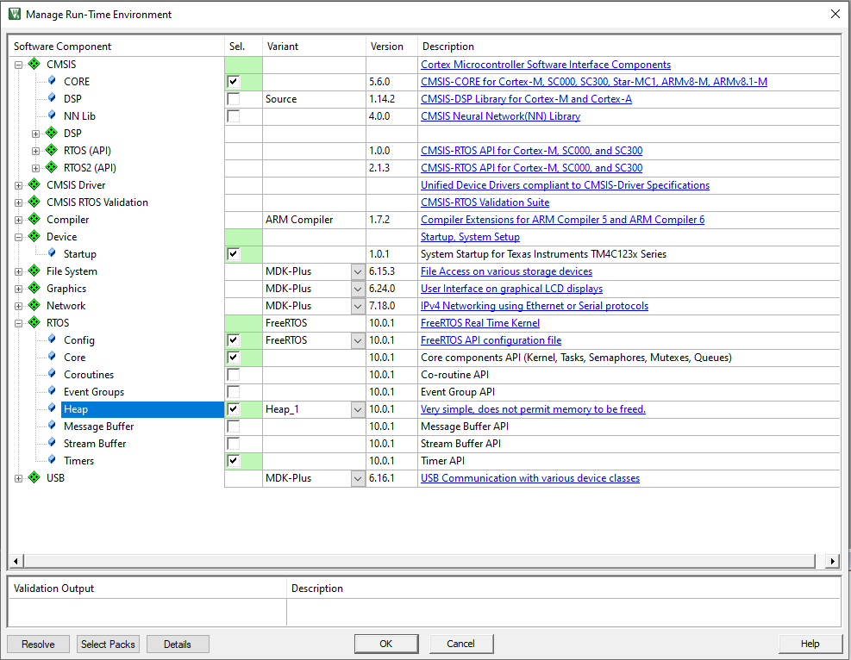
Setup Project Dependancies
Select the following dependencies taking care of the following:
FreeRTOS is being used (V10.0.1)
Heap_1 selected * this may change as the project is more understood
Once Finished, Click OK

Slide 5
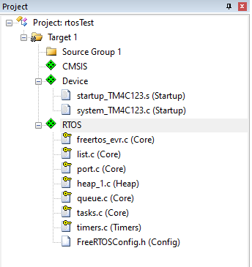
Check Project Explorer
Your project template is now created, ensure the following structure
Notice there is no main.c file…

Slide 6
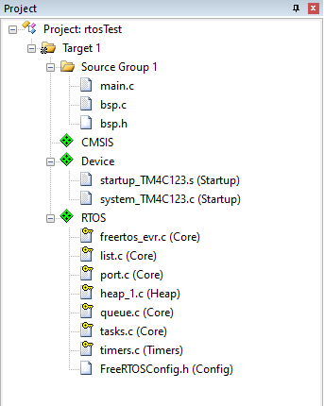
Add main.c and BSP
Head over to the Unicorn RTOS Github repo and collect a copy of the following files from the freeRTOS branch
Main.c, bsp.c, bsp.h
After adding the files, your project structure should now look like this:

Slide 7
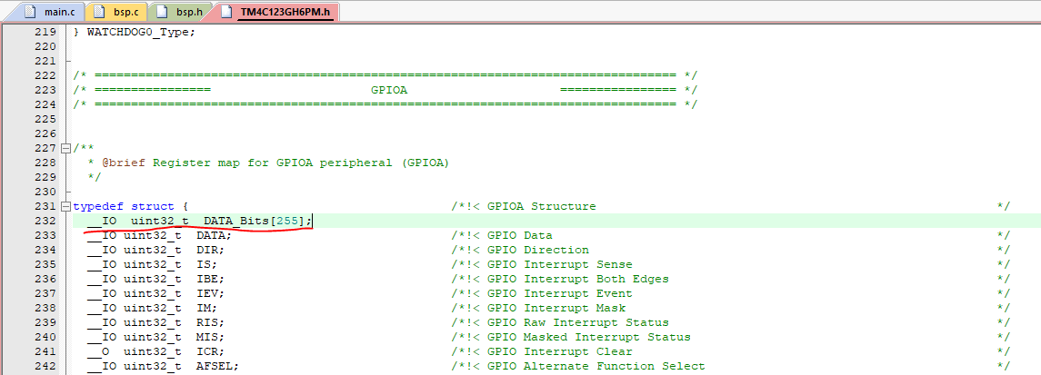
Modify the Target Header File
Modify the following file in the GPIOA Register map
This is a read-only file - Modify under properties to allow editing
This file also exists in the repo – can also simply replace the file

Slide 8
Setup Compiler and Other Options
If you try to compile the code at this point, you should receive a lot of errors and warnings.
We still need to setup the project settings / Compiler
To do this, Open the following View (Options for Target)

Slide 9
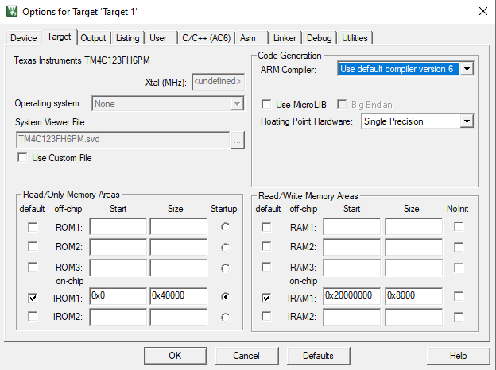
Options for Target: Target Tab
Ensure the following options are set:

Slide 10
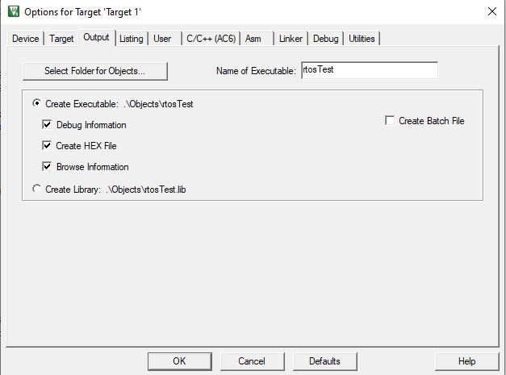
Options for Target: Output Tab
Ensure the following options are set

Slide 11
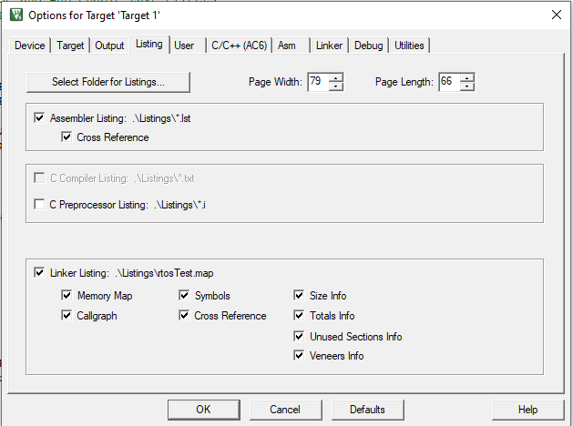
Options for Target: Listing Tab
Ensure the following options are set

Slide 12
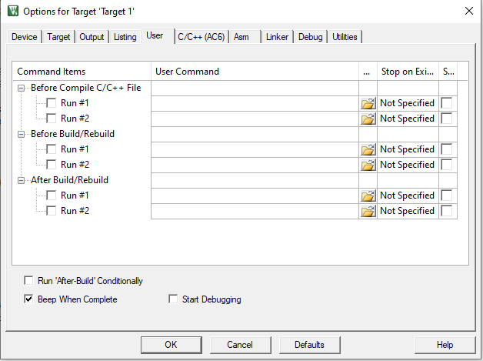
Options for Target: User Tab
Ensure the following options are set

Slide 13
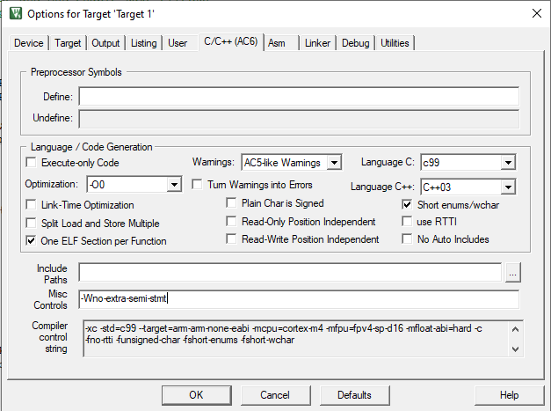
Options for Target: C/C++ (AC6) Tab
Ensure the following options are set

Slide 14
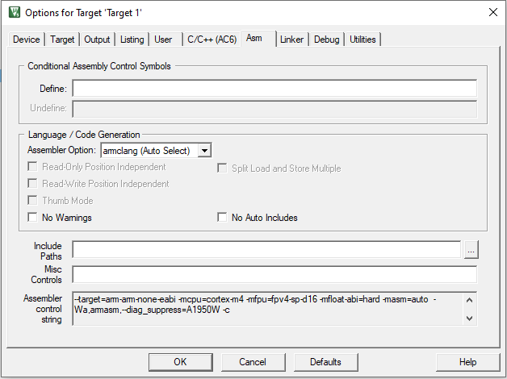
Options for Target: Asm Tab
Ensure the following options are set

Slide 15
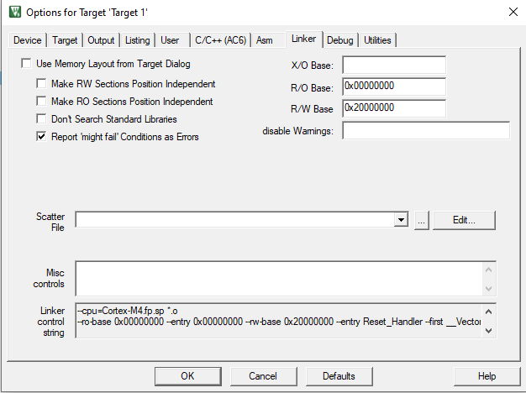
Options for Target: Linker Tab
Ensure the following options are set

Slide 16
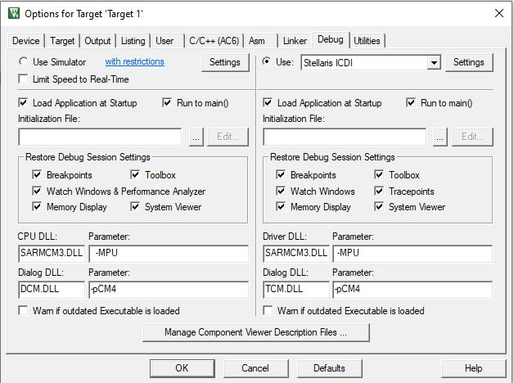
Options for Target: Debug Tab
Ensure the following options are set
Note: If you don’t have a Stellaris ICDI listing please download the extension here: https://developer.arm.com/documentation/ka002280/latest

Slide 17
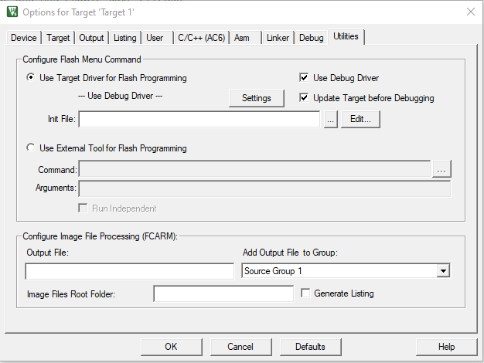
Options for Target: Utilities Tab
Ensure the following options are set

Slide 18
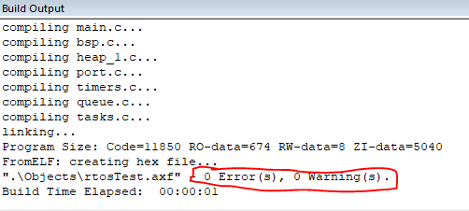
Clean Project and Rebuild
After verifying correct Project Options:
Select Project->Clean Targets
Select Project->Rebuild all Target Files
The build output should now show 0 Errors / 0 Warnings

Slide 19
Running the code on-board
Watch out, that LED is BRIGHT
Connect your board to an available USB port
Run the debugger by clicking on the debug icon

Slide 20
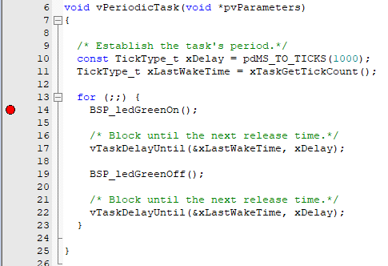
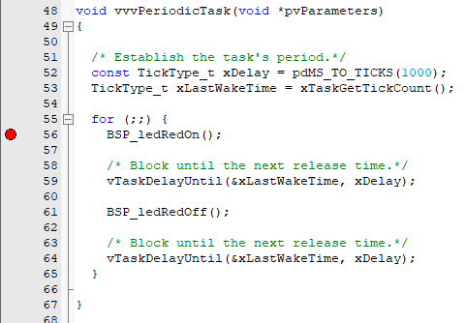
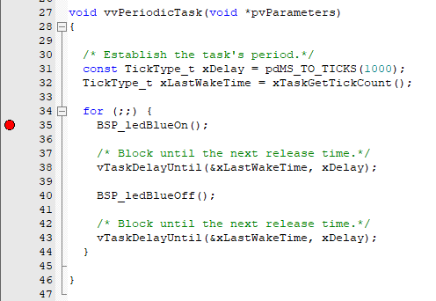
Running the code on-board
Before running the code, place three breakpoints:
Run the code and notice each time a breakpoint is hit, it’s the next LED blinking task. All tasks are running.
When free running the code without breakpoints, notice the color of the LED – It’s white. This is because we are blinking all three colors at the “same time”, producing a white color.
Green Blink Task
Red Blink Task
Blue Blink Task

Slide 21
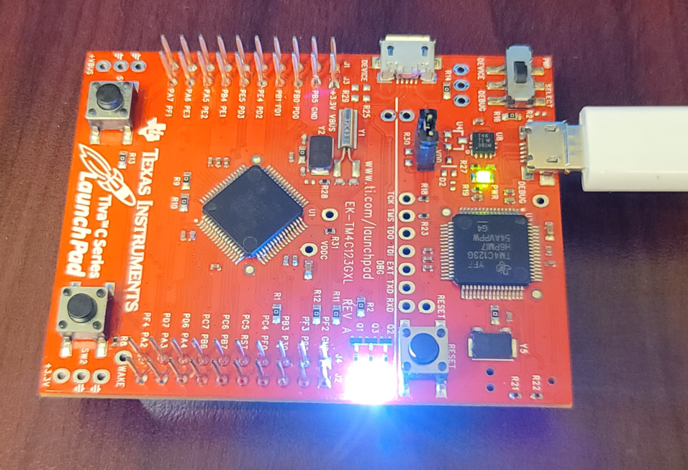
Congrats!

